Slide 1
SOFTWARE DEVELOPMENT PROJECT MANAGEMENT (CSC4125)
Lecture 9: Resource Allocation

Slide 2
What is Resource Allocation?
After the activities have been identified using various techniques and tabulated into a Work-Breakdown, the resources need to be allocated to complete the identified tasks. This process is considered resource allocation.

Slide 3
Resource Allocation
Allocation of resources to activities leads to –
Review and modify the activity plan
Revise stages
Revise project completion dates

Slide 4
Result of Resource Allocation
The result of resource allocation –
Activity schedule
Indicating planned start and completion dates for each activity
Resource schedule
Showing the dates on which each resource will be required and the level of that requirement
Cost schedule
Showing planned cumulative expenditure incurred by the use of resources over time

Slide 5
What is Resource?
A resource is any item or person required for the execution of the project.
Some resources will be required for the duration of the project (e.g. project manager) whereas others might be required for a single activity (e.g. a specific software developer).
The project manager must concentrate on those resources which, without planning, might not be available when required.

Slide 6
Resource Categories
In general, resources fall into one of the seven categories –
Labor
Equipment
Materials
Space
Services
Time
Money

Slide 7
Resource Categories: Labor
Members of the development project team –
Project manager
Systems analysts
Software developers
QA team
Other support staff
Any employee of the client organization who might be required to undertake/participate in specific activities

Slide 8
Resource Categories: Equipment
Workstations and other computing and office equipment.
Note: We must not forget that staff also need basic equipment such as desks and chairs!

Slide 9
Resource Categories : Materials
Materials are items that are consumed (rather than equipment that is used)
They are of little consequence in most software projects but can be important for some – software that is to be widely distributed might require supplies of disks to be specially obtained.

Slide 10
Resource Categories : Space
Office space
For projects that are undertaken with existing staff, space is normally readily available
However, if any additional staff (recruited/contracted) should be needed then office space will need to be found

Slide 11
Resource Categories : Services
Some specialist services –
Telecommunicating
Cleaning services

Slide 12
Resource Categories : Time
Time is the resource that is being offset against the other primary resources.
Project timescales can sometimes be reduced by increasing other resources and will almost certainly be extended if they are unexpectedly reduced
Elapsed time can often be reduced by adding more staff
The most rigid item of all

Slide 13
Resource Categories : Money
Money is used to buy other resources.
Money is a secondary resource (secondary in the sense that it is calculated from the others)
Money is the means by which one resource can be converted to another. However in practice this may be problematic because of resource constraints e.g. staff need time to become expert in a new technology regardless of the amount of money that might be available to buy expertise

Slide 14
Resource Allocation
Identify the resources needed for each activity
Identify resource types - individuals are interchangeable within the group (e.g. ‘VB programmers’ as opposed to ‘software developers’)
Allocate resource types to activities and examine the resource histogram

Slide 15
Resource Allocation
Note: At this point we have to assume that we are dealing with, for example, ‘standard’ software developers who have an average productivity. When we allocate actual people we may find that we have a trainee or a super-expert and this will affect productivity. A short-coming in productivity in an individual might be compensated for by a lower cost (as would be expected with trainees).

Slide 16
Resource Histogram for Systems Analysts
5
4
# OF STAFF REQD.
3
2
1
1
2
3
4
5
6
7
WEEK
The resource histogram helps us identify where the demand for a resource exceeds the supply.

Slide 17
Resource Histogram
Commonly used during planning to indicate possible problem areas
People (by category) vs. Week Number
For each individual – estimated number of tasks (including complexity) over weeks
This helps in reducing work load sometimes to help the individual recover from any heavy load

Slide 18
Resource Clashes
Resource clashes can be resolved by:
Delaying one of the activities
taking advantage of float to change start date
delaying start of one activity until finish of the other activity that resource is being used on
➔ puts back project completion
Moving resource from a non-critical activity
Bringing in additional resource ➔ increases costs

Slide 19
Prioritizing Activities
Where more than one activity is competing for the same limited resource at the same time then those activities need to be prioritized. There are two main ways of doing this:
Total float priority
those with the smallest float have the highest priority
Ordered list priority
this takes account of the duration of the activity as well as the float

Slide 20
Prioritizing Activities
Total Float Priority
Activities are ordered according to their total float
Activity with the smallest total float has the highest priority
Activities are allocated resources in ascending order of total float
Changes to plan will require re-calculation of floats
Note: Float time = Slack time

Slide 21
Prioritizing Activities
Ordered List Priority
Activities that can proceed at the same time are ordered according to a set of simple criteria.
An example of this is Burman’s priority list, which takes into account activity duration as well as total float.

Slide 22
Burman’s priority list
Give priority to:
Shortest critical activity
Other critical activities
Shortest non-critical activity
Non-critical activity with least float
Non-critical activities

Slide 23
Resource Usage
Need to maximize % usage of resources, i.e. reduce idle periods between tasks
Need to balance costs against early completion date
Need to allow for contingency

Slide 24
Critical path
Scheduling resources can create new dependencies between activities – recall critical chains
It is best not to add dependencies to the activity network to reflect resource constraints
Makes network very messy
A resource constraint may disappear during the project, but link remains on network
Instead, amend dates on schedule to reflect resource constraints

Slide 25
Allocating individuals to activities
The initial ‘resource types’ for a task have to be replaced by actual individuals.
When allocating laborers to activities, we need to be specific among individuals –
Nature of software development
Skill and experience influence
Time taken
Quality of the product

Slide 26
Allocating individuals to activities
Factors to be considered in allocating individuals to tasks:
Availability
Criticality
Risk
Training
Team building

Slide 27
Factors to be considered in allocating individuals to tasks
Availability – Is he/she available when required?
Criticality – Allocation of experienced personnel to activities on the critical path. (i.e. You would want to put your more experienced, ‘safer’, staff on the critical activities)
Risk –Allocating the most experienced staff to the highest-risk activities is likely to have the greatest effect in reducing overall project uncertainties.
Training – Allocate junior staff to appropriate non-critical activities where there will be sufficient slack for them to train and develop skills
Team building – The selection of individuals must also take account of the final shape of the project team and the way they will work together. Identifying people who work well together can pay dividends; chopping and changing plans all the time may in theory optimize project performance, but can in practice be de-motivating for staff

Slide 28
Cost Schedules
Calculating cost is straightforward where the organization has standard cost figures for staff and other resources. Where this is not the case, the project manager will have to calculate the costs.
In general, costs are categorized as –
Staff costs
Overheads
Usage charges

Slide 29
Cost Schedules
Staff costs
Salaries, employers contribution to social security, pension, holiday pay, sickness benefit
Contract staff is charged by the week/month (even if they are idle)
Overheads
Expenditures that organization incurs, which can not be directly related to individual projects/jobs
space rent, interest charges, travel cost, insurance, costs of service departments
These can equal or even exceed the direct employment costs
Usage charges
Charged directly for use of resources, e.g. computer time
Some charges can be on a ‘pay as you go’/ ‘as used’ basis, e.g. telephone charges, postage, car mileage – at the planning stage an estimate of these may have to be made

Slide 30
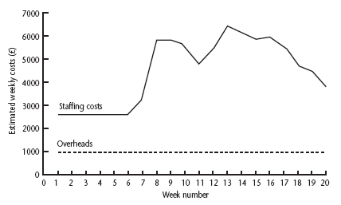
Cost Profile: Weekly Project Costs
This shows how much is going to be spent in each week. This could be important where an organization allocates project budgets by financial year or quarter and the project straddles more than one of these financial periods

Slide 31
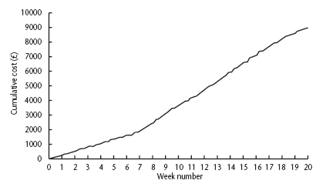
Cumulative Project Costs
The project manager will also be concerned about planned accumulative costs. This chart can be compared to the actual accumulative costs when controlling the project to assess whether the project is likely to meet its cost targets.

Slide 32
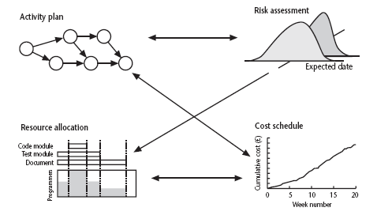
Balancing concerns
Successful project scheduling is not a simple sequence.
Because of the inter-linking of different concerns, project planning will need to be iterative. The consequences of decisions will need to carefully assessed and plans adjusted accordingly.

